Slide 1
Muscular system
Approximately 700 muscles

Slide 2
Functions of the muscular system
Produce movement – muscles pull on bones
Maintain posture and body position – continuous muscle contractions allow us to sit or stand
Support soft tissue – abdominal wall and pelvic floor are layers of muscle that support organs
Guard entrances and exits – muscle encircles openings in the digestive and urinary tracts
Maintain body temp. – energy released by muscles heats the body.

Slide 3
Muscle arrangement
Arranged in bundles
Epimysium – Surrounds muscle and separates it from other tissues.
Perimysium – divides muscle into bundles of fibers (fascicles)
Contains blood vessels and nerves
Endomysium – holds individual muscle fibers together within fascicles
All three layers form the tendons that attach to the periosteum of bone.(made of collagen)

Slide 5
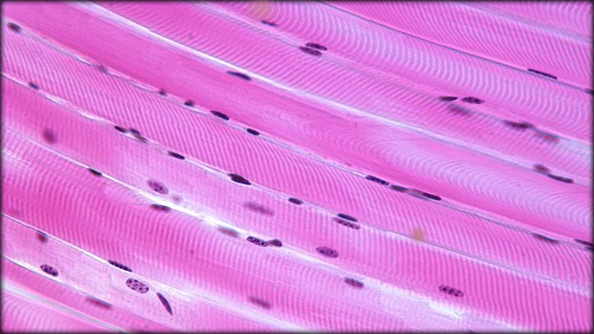
Muscle cells
Muscle fibers are individual cells
Larger than most (leg muscle 30cm long)
Contain many nuclei

Slide 6
Muscle cell arrangement
Surrounded by the sarcolemma (cell membrane)
Filled with sarcoplasm
Transverse or T tubules
Network of tubes w/in the muscle cells
Conducts electrical impulse to the interior of the sarcoplasm
Sarcoplasmic reticulum
Modified Smooth ER
Have extensions called cisterna which store calcium ions and are used in contraction.

Slide 8
Muscle cell contined
Myofibrils
Circular structure within muscle cells
Contain myofilaments
Banded appearance
Made of the proteins actin and myosin
Attach to the ends of the of the cell
As the myofilament contracts the whole cell contracts
Mitochondria and glycogen (glucose source) are scattered throughout the cell

Slide 9
Myofilaments
Organized into repeating groups called sarcomeres (10,000 sarcomeres/myofibril)
Thick filaments (myosin) at the center
Thin filaments (actin) at the ends
Thin filaments are connected by proteins which make the z line
Z line – border of the sarcomere
M line – Where thick filaments are attached
Center of the sarcomere

Slide 10
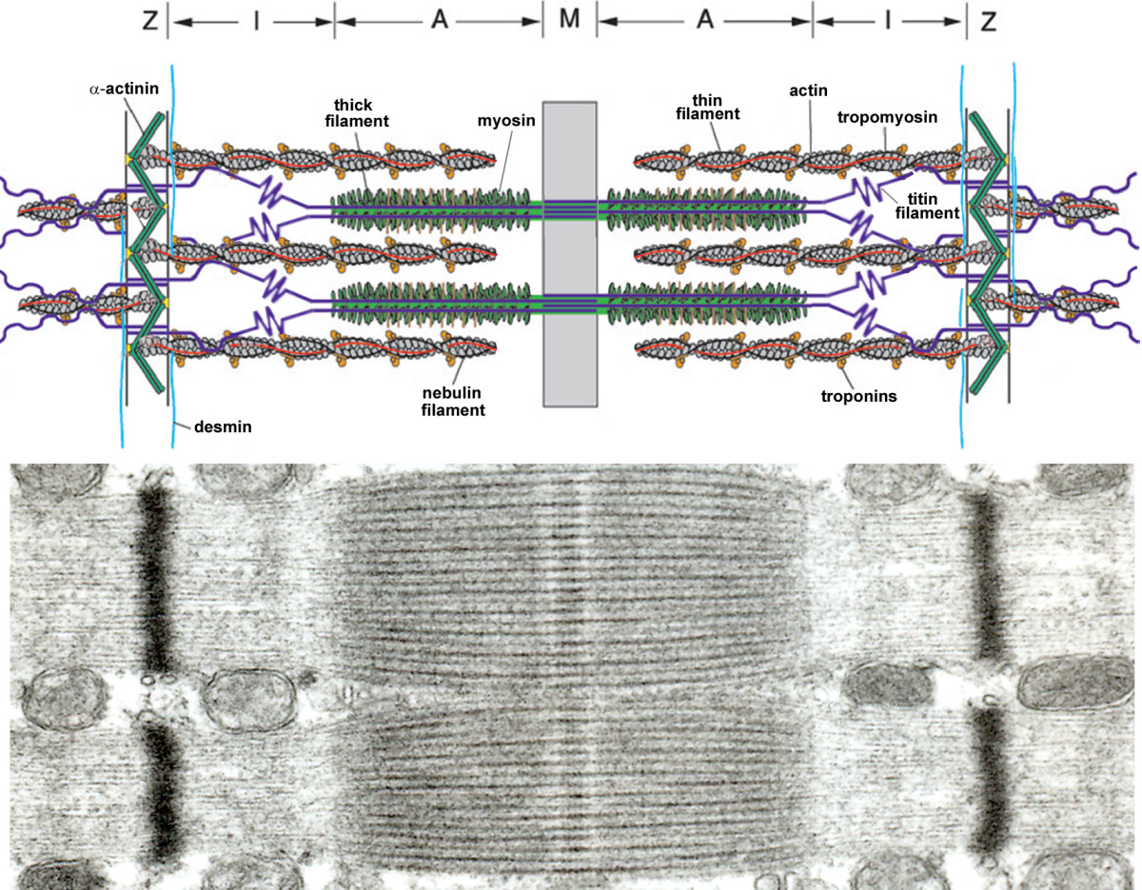

Slide 11
Recap
Sarcomeres > myofilaments > Myofibrils > Muscle fibers > Fascicles > Muscle

Slide 12
Muscle striations
Caused by size difference in filaments
Dark portions are the thick filaments (myosin)
A band
Light areas are the thin filaments (actin)
I band

Slide 13
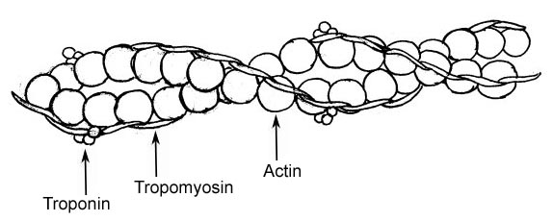
Thin Filaments
Twisted strands of actin molecules
Contain active sites which are covered by strands of tropomyosin
Strands held together by troponin

Slide 14
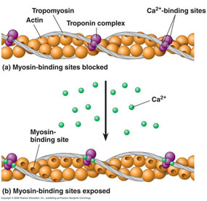
Thick Filaments
Myosin molecules
Have a head and tail
Tails are attached at the M line
Heads attach to actin during contraction
Troponin must change to move tropomyosin off of the active sites
Ca⁺ released from the cisterna cause troponin to change shape

Slide 15
Sliding Filaments
When sarcomere contract
I bands get smaller
Z lines move closer together
The width of the A band doesn’t change
So thin filaments must slide toward the center of the sarcomere
Thick filaments are stationary
Sliding filament theory

Slide 16
Cross bridges
Myosin head binds to active site on actin
Heads → known as cross bridges
Myosin head pivots toward the center of the sarcomere
Pulls thin filament toward the center
Myosin detaches and resets with the addition of ATP
Attach, pull, detach, reset

Slide 17
Cross Bridges

Slide 18
Concept check questions pg 182
How would severing the tendon attached to a muscle affect the ability of a muscle to move that body part?
Since the tendon attached muscle to bone, severing the tendon would disconnect the muscle from the bone. When the muscle contracted, nothing would happen.

Slide 19
Concept check questions continued
2. Why would skeletal muscles appear striated when viewed through a microscope?
Because of the arrangement of the repeating arrangement of actin and myosin myofilaments.
3. Where would you expect to find the greatest concentration of calcium in resting skeletal muscle cells?
Within the cisternae of the sarcoplasmic reticulum.

Slide 20
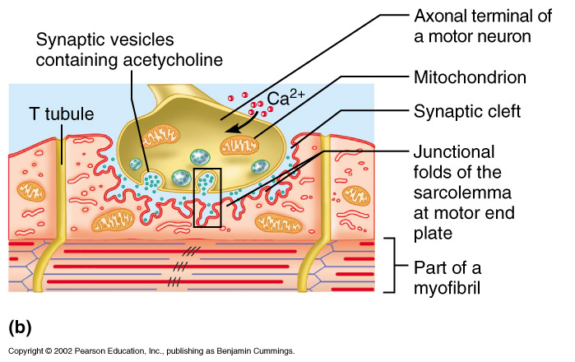
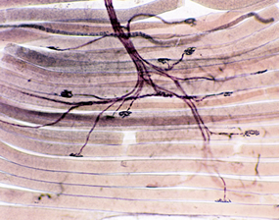
Controlling the contraction (push hunny push)
Muscle fibers are controlled by the nervous system through neuromuscular junctions
Nerve cell communicates with a muscle cell

Slide 21
Motor neuron releases acetylcholine (ACh), a neurotransmitter
ACh binds to receptor on the sarcolemma which causes Na⁺ to rush in to the sarcoplasm and produce an action potential.
The action potential travels down the muscle fiber and the T-tubules, which makes the cisternae release Ca⁺
ACh is broken down by acetylcholinesterase
See page 183

Slide 22
Concept check pg 184
How would a drug that interferes with cross-bridge formation affect muscle contraction?
If cross bridges cannot be form then the muscle cannot contract.
What would you expect to happen to a resting skeletal muscle cell if the sarcolemma suddenly became very permeable to calcium ions?
Increased calcium concentration would result in increased contraction, also the muscle would not be able to relax if calcium is present.

Slide 23
Concept check
What would happen to a muscle if there was no acetylcholinesterase present?
The muscle would not be able to stop contracting as the acetylcholine would continue to tell the cisternae to release calcium.

Slide 24
Muscle mechanics “You ain’t using this bicep tonight!”
Muscles can pull and produce tension but they cannot push and produce compression.
All or none principle
All of the sarcomere of a fiber contract or none do. So a muscle fiber can only produce a set amount of tension
The amount of tension that the muscle as a whole can produce is controlled by
Frequency of stimulation
# of fibers activated.

Slide 25
Motor units
All of the muscle fibers controlled by a single motor neuron
Allows for the control of amount of tension in a muscle
Fine control → few fibers/neuron
Eye muscles → 2 fibers /neuron
Gross control → many fibers /neuron
Leg muscle → 2000fibers/neuron
Motor units are intermingled in the muscle to produce a smooth pull.

Slide 26
Motor units

Slide 27
Types of contractions
Isotonic contractions
Tension rises in muscle until the length of the muscle decreases
Lifting an object
Isometric contractions
Tension rises in the muscle but does not cause a change in length.
Pushing on a wall, sitting upright

Slide 28
After contraction
Returning muscle to its relaxed length is a passive process.
Elasticity (organelles don’t like to be squished)
Opposing muscles
Gravity

Slide 29
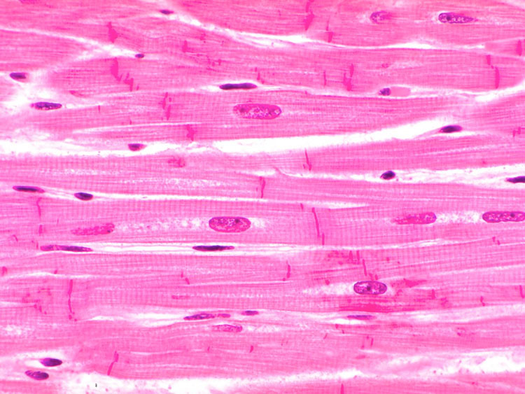
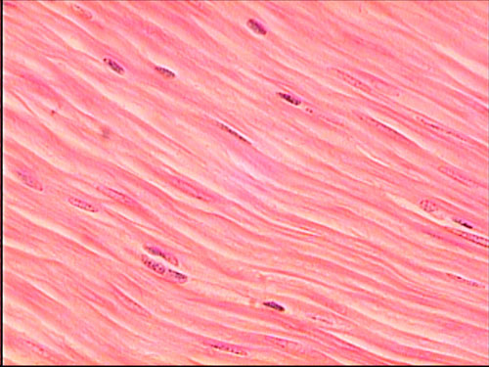
Other muscle types (pg 193)
Cardiac muscle
Muscle of the heart
Smooth muscle
In most organs, around
blood vessels, form
sphincters

Slide 30
Origin, insertion, and action
Origin
Where the muscle begin
Generally stays stationary
Insertion
Where the muscle ends
Generally more mobile
Action
The movement the muscle causes
Gastrocnemius muscle – inserts at the distal end of the femur and inserts on the calcaneus and cause dorsiflexion

Slide 31
Describing muscles by their prime action
Prime mover (agonist) – main force for a specific movement
Biceps are agonist for flexion of the elbow
Antagonist – opposes the movement of the prime mover
Triceps are the antagonists of the biceps

Slide 32
Synergist – helps the prime mover work more efficiently
Deltoids abduct the arm with the supraspinatus assisting at starting the movement.
Fixators – stabilize the origin of the prime mover to prevent moving another joint.

