Slide 1
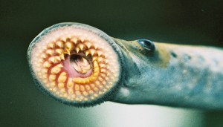
Sea Lamprey C-Lamp-Ray
“Sea What I did there?”
By: Kent Heenan

Slide 2
Sea Lamprey: Origins
Sea lamprey originate in the Atlantic Ocean and debate rages over if they are native to Lake Ontario because by 1836 they had been documented being in there and no one had documented all the aquatic life in that lake before hand leading to speculation

Slide 3
Attack of the Sea Lamprey
The Sea Lamprey then moved on from Ontario to Lake Erie through the use of man made waterways such as canals and then from Lake Erie the Sea Lamprey now more of a Lake Lamprey, went from Lake Erie to all the other great lakes.

Slide 4
Actions to stop the Lamps
Because of the dramatic impact the Sea Lamprey are having on the local fish populations and the economy many wildlife groups have tried hunting down their elusive nesting sites and destroying them, but this proved a fatal error as the Sea Lamprey nest next to important fish species so the fish had been caught in the cross-fire in the war against the Lamprey. Eventually people started building artificial structures to prevent lampreys from returning to their nesting grounds to lay eggs thus stopping entire generations from being born and letting the fish they want saved through.

Slide 5
The Price of the Lamprey Scourge
The Sea Lamprey would go on to absolutely decimate the populations of native fish, in 1980 80% of the fish harvested that year had shown signs of Sea Lamprey attacks that being huge gaping wounds on the side of their body where the parasitic lamprey would attach and absolutely eviscerate the fish’s side. This and the sheer amount of dead fish hurt the fishing industry in places such as North Michigan.

Slide 6
How the Lamp-Ray Strikes
All Lampreys at least generally speaking are parasitic feeders, the Sea Lamprey is no different. The Lamprey finds a fish and then it rams itself into the side of the fish and then uses its teeth to latch on and stay on to the fish. Then using its razor sharp tongue it slashes at the bit of fish flesh exposed to it until the fish starts to bleed out quite a lot then it naturally injects the fish with a chemical that prevents blood clotting so it stays on the fish until it drains it of all its blood then it detaches itself from the corpse and moves on. ABSOLUTELY VICIOUS!

Slide 7
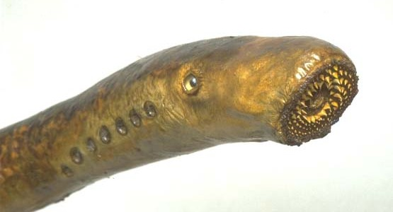
Works Cited
GLFC – The Great Lakes Fishery Commission
Wisconsin department of Natural Resources
www.protectourwaters.net
USGS – United States Geological Survey

